Slide 1
Demystifying ESG in the EU
CONVENE ESG
Laura Corazza

Slide 2
Introduction to the reporting landscape

Slide 4
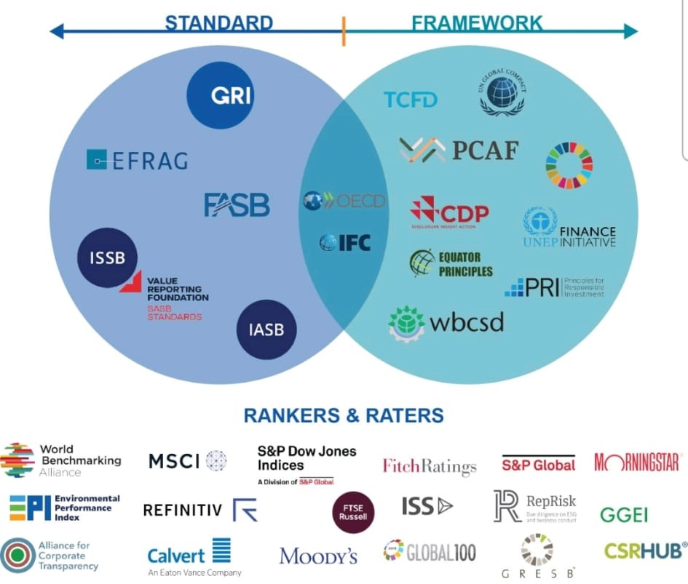
International reporting landscape

Slide 5
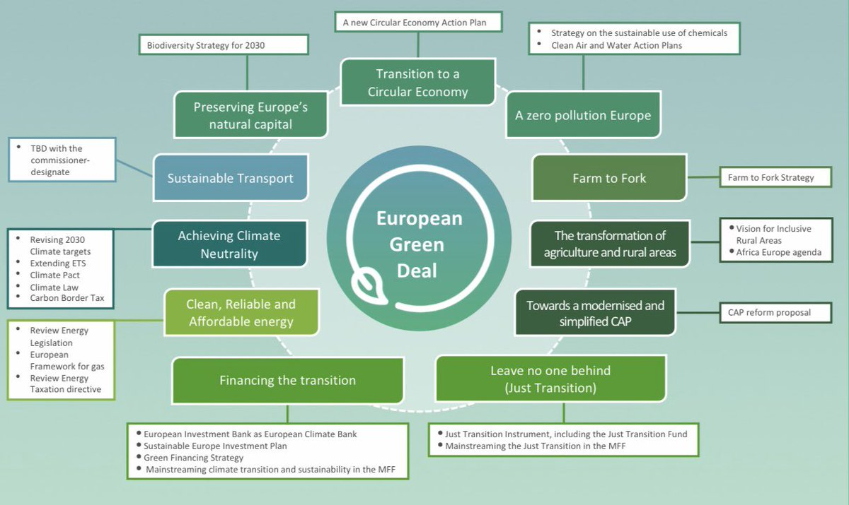
European Strategy
The European Green Deal is a strategy that establishes targets, timeframes and actions to implement the decarbonization of the European Union, i.e., the overall reduction of emissions by 55 percent by 2030 and the achievement of climate neutrality by 2050. #fitfor55

Slide 6
European Taxonomy
Regulation (EU) 2020/852: In order to increase market transparency and investor confidence by directing more investment in sustainable projects, the Regulation provides a framework for creating a unified EU-wide classification system for environmentally sustainable economic activities.
The goal is to create a common language and methodology for investors to determine economic activities by applying environmental considerations. This will enable investors to identify, rank and compare the sustainability credentials of companies and financial instruments, thereby channeling capital flows into sustainable finance. The regulation went into effect on July 12, 2020.
The six environmental objectives of the Taxonomy are:
climate change mitigation,
climate change adaptation,
sustainable use and protection of water and marine resources
transition to a circular economy
pollution prevention and control
protection and restoration of biodiversity and ecosystems

Slide 7
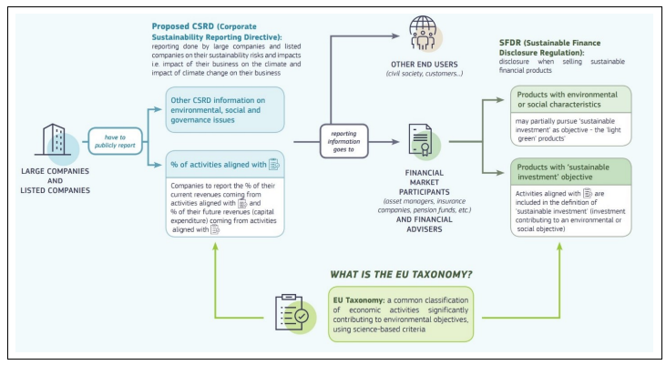

Slide 8
Recent changes in global economies
Business relationship with the banking system: the third pillar of Basel III, on ESG risk assessment and reporting, requires granular and comparable data on ESG risk exposures for verifying capital strength and creditworthiness. These requirements have been formalized and implemented, between 2020 and 2022, by the Guidelines and Technical Recommendations of the EBA and ECB
Emissions: in addition to the first year of CSRD implementation, 2024 may also prove to be the year of issuance of the final version of the Securities and Exchange Commission's (SEC) "The Enhancement and Standardization of Climate-Related Disclosures for Investors Rule" (Scope 1, 2 and 3 of the GHG Protocol). Scope 3 disclosure affects emissions within an organization's value chain, with a substantial role in transition risks
Application of the "Do No Significant Harm" (DNSH) principle: The application of the DNSH principle set forth in Regulation (EU) 241/2021, the European Union Recovery and Resilience Plan, also has implications on the public administration relations front under the new Procurement and Public Contracts Code (the reform of which came into effect on April 1, 2023) and results in the assessment of whether interventions comply with the DNSH principle against the six environmental objectives identified in the Paris Agreement
CSDDD The CSDDD will require companies to implement due diligence strategies to mitigate violations of human rights and negative environmental impacts resulting from their operations. Companies of a certain size will also need to adopt and implement a plan to ensure that their business strategy is compatible to limit global warming to 1.5°C, in line with the Paris Agreement. The general thresholds of the proposal were increased to reduce the number of EU and non-EU companies falling within the scope of the Directive (from 500 employees to 1000, from a turnover of €150 million to €300 million).

Slide 9
Corporate Sustainability Reporting Directive (CSRD)

Slide 10
What is the CSRD about?
Reporting requirements for large companies and listed companies in the EU, concerning social and environmental risks and the impact of their operations. It amends the previous NFRD, expanding the number of companies involved to approximately 49,000, and introduces more detailed requirements for sustainability reporting.

Slide 11
CSRD – Background information
The CSRD amends Directive 2013/34 (Accounting Directive "AD"), Directive 2004/109/EC (Transparency Directive "TD"), Directive 2006/43/EC (Audit Directive "AuD"), and Regulation (EU) No 537/2014 (Audit Regulation).
The CSRD revises and strengthens sustainability reporting requirements for companies introduced by Directive 2014/95 (Non-Financial Reporting Directive "NFRD") into the Accounting Directive.
Key element of the EU Green Deal.
Objective: to place Sustainability Reporting on par with Financial Reporting.
Published in the Official Journal in December 2022 (Directive 2022/2464).

Slide 12
From NFRD to CSRD

Slide 13
Timeline and phased implementation
From January 1st, 2024, reporting requirements apply to the first group of affected companies, and the first CSRD-compliant reports must be published by 2025. Subsequently, the CSRD will be gradually applied to more companies:
From 2025, companies with more than 250 employees and a balance sheet exceeding €20 million or net turnover exceeding €40 million are affected.
From 2026, EU-based listed SMEs will be affected. However, they can choose not to adhere until the reporting year 2028.
From 2028, non-EU companies with a net turnover exceeding €150 million in the EU and with a subsidiary or office in the EU with a turnover exceeding €40 million are affected.
Member States must transpose the CSRD into their national laws by July 6, 2024.

Slide 14
Double materiality logic
Information needed to understand the company's impact on sustainability issues (inside-out perspective) and how sustainability issues affect company performance, situation, and performance (outside-in perspective)

Slide 15
Other novelties
Increased level of responsibility for administrative, management and supervisory bodies
elimination of the possibility of preparing a separate report
extension of reporting to the value chain
format in which to disseminate information

Slide 16
LSME and VSME
LSMEs (Listed) on EU financial markets will be subject to sustainability reporting requirements imposed by the CSRD. However, reporting standards are expected to be proportionate to the capacities and resources of these enterprises.
VSMEs, are exempt from reporting obligations under the CSRD. This exemption aims to mitigate the administrative burden on smaller businesses, which may not have the resources to meet extensive reporting requirements without a significant impact on their operations. The objective:
Contributing to a more sustainable and inclusive economy;
Improving the management of sustainability issues they face;
Providing information to meet the demand for data from financiers/credit providers and investors;
Providing information to meet the demand for data from large enterprises that require sustainability information from their suppliers.

Slide 17
European Sustainability Reporting Standard

Slide 18
ESRS
The European Commission adopted the delegated act to approve the Delegated Regulation containing ESRS sustainability reporting standards.
Three categories of sustainability reporting standards:
Cross-cutting standards (2)
Thematic Standards:
Environmental (5)
Social (4)
Governance and Ethics (1)
Sectoral Standards.

Slide 19
Basic elements
Four strategic axes on which the company must express itself for each issue.
Governance
Strategy
Management of impacts, risks and opportunities
Metrics and goals

Slide 20
European Sustainability Reporting Standard (ESRS)
ESRS 1 General requirements
ESRS 2 General disclosures
ESRS E1 Climate change
ESRS E2 Pollution
ESRS E3 Water and marine resources
ESRS E4 Biodiversity and Ecosystems
ESRS E5 Resource use and circular economy
ESRS G1 Business conduct
ESRS 1 Own workforce
ESRS S2 (Workers in the value chain), S3 (Affected communities) and S4 (Consumers and end-users)

Slide 21
Materiality approach: double materiality

Slide 22
Starting point
To think about the main relevant impacts of the business applying the logic of materiality
Energy Waste Water Materials Emissions
HRM practices - HRM composition – Welfare
Use the GRI as an initial source of indicators/KPIs to start thinking about impacts
Start collecting data

